Slide 1
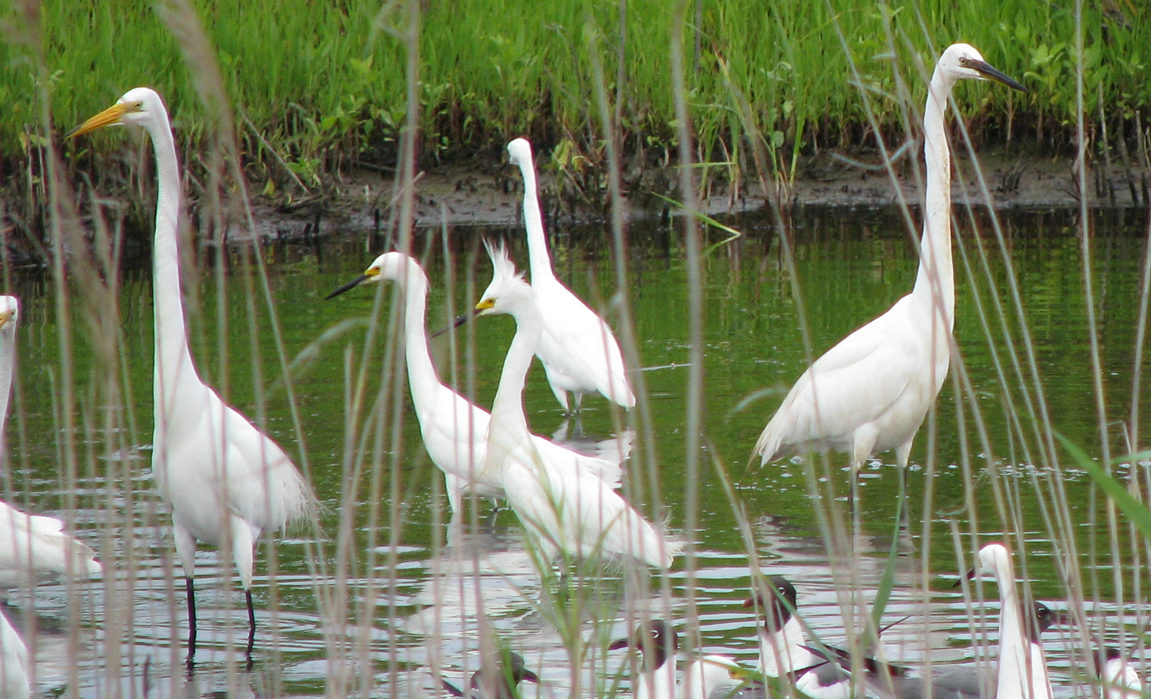

EGRET: Exploration and Graphics for RivEr Trends
An R-package for the analysis of long-term changes in river-water quality and streamflow, including the water quality method “Weighted Regressions on Time, Discharge, and Season” (WRTDS)
Developed by
Bob Hirsch &
Laura De Cicco:
In Beta testing

Slide 2
The WRTDS analysis is a method that has been described in peer reviewed publications
Links to these papers, plus the R-packages, draft manual and this presentation are on the EGRET web site
https://github.com/USGS-CIDA/WRTDS/blob/master/README.md

Slide 3
The driving philosophy for WRTDS and EGRET:
“The only way to figure out what is happening to our planet is to measure it,
and this means tracking changes decade after decade
and poring over the records.”
(Ralph Keeling, Science Magazine, 2008)

Slide 4
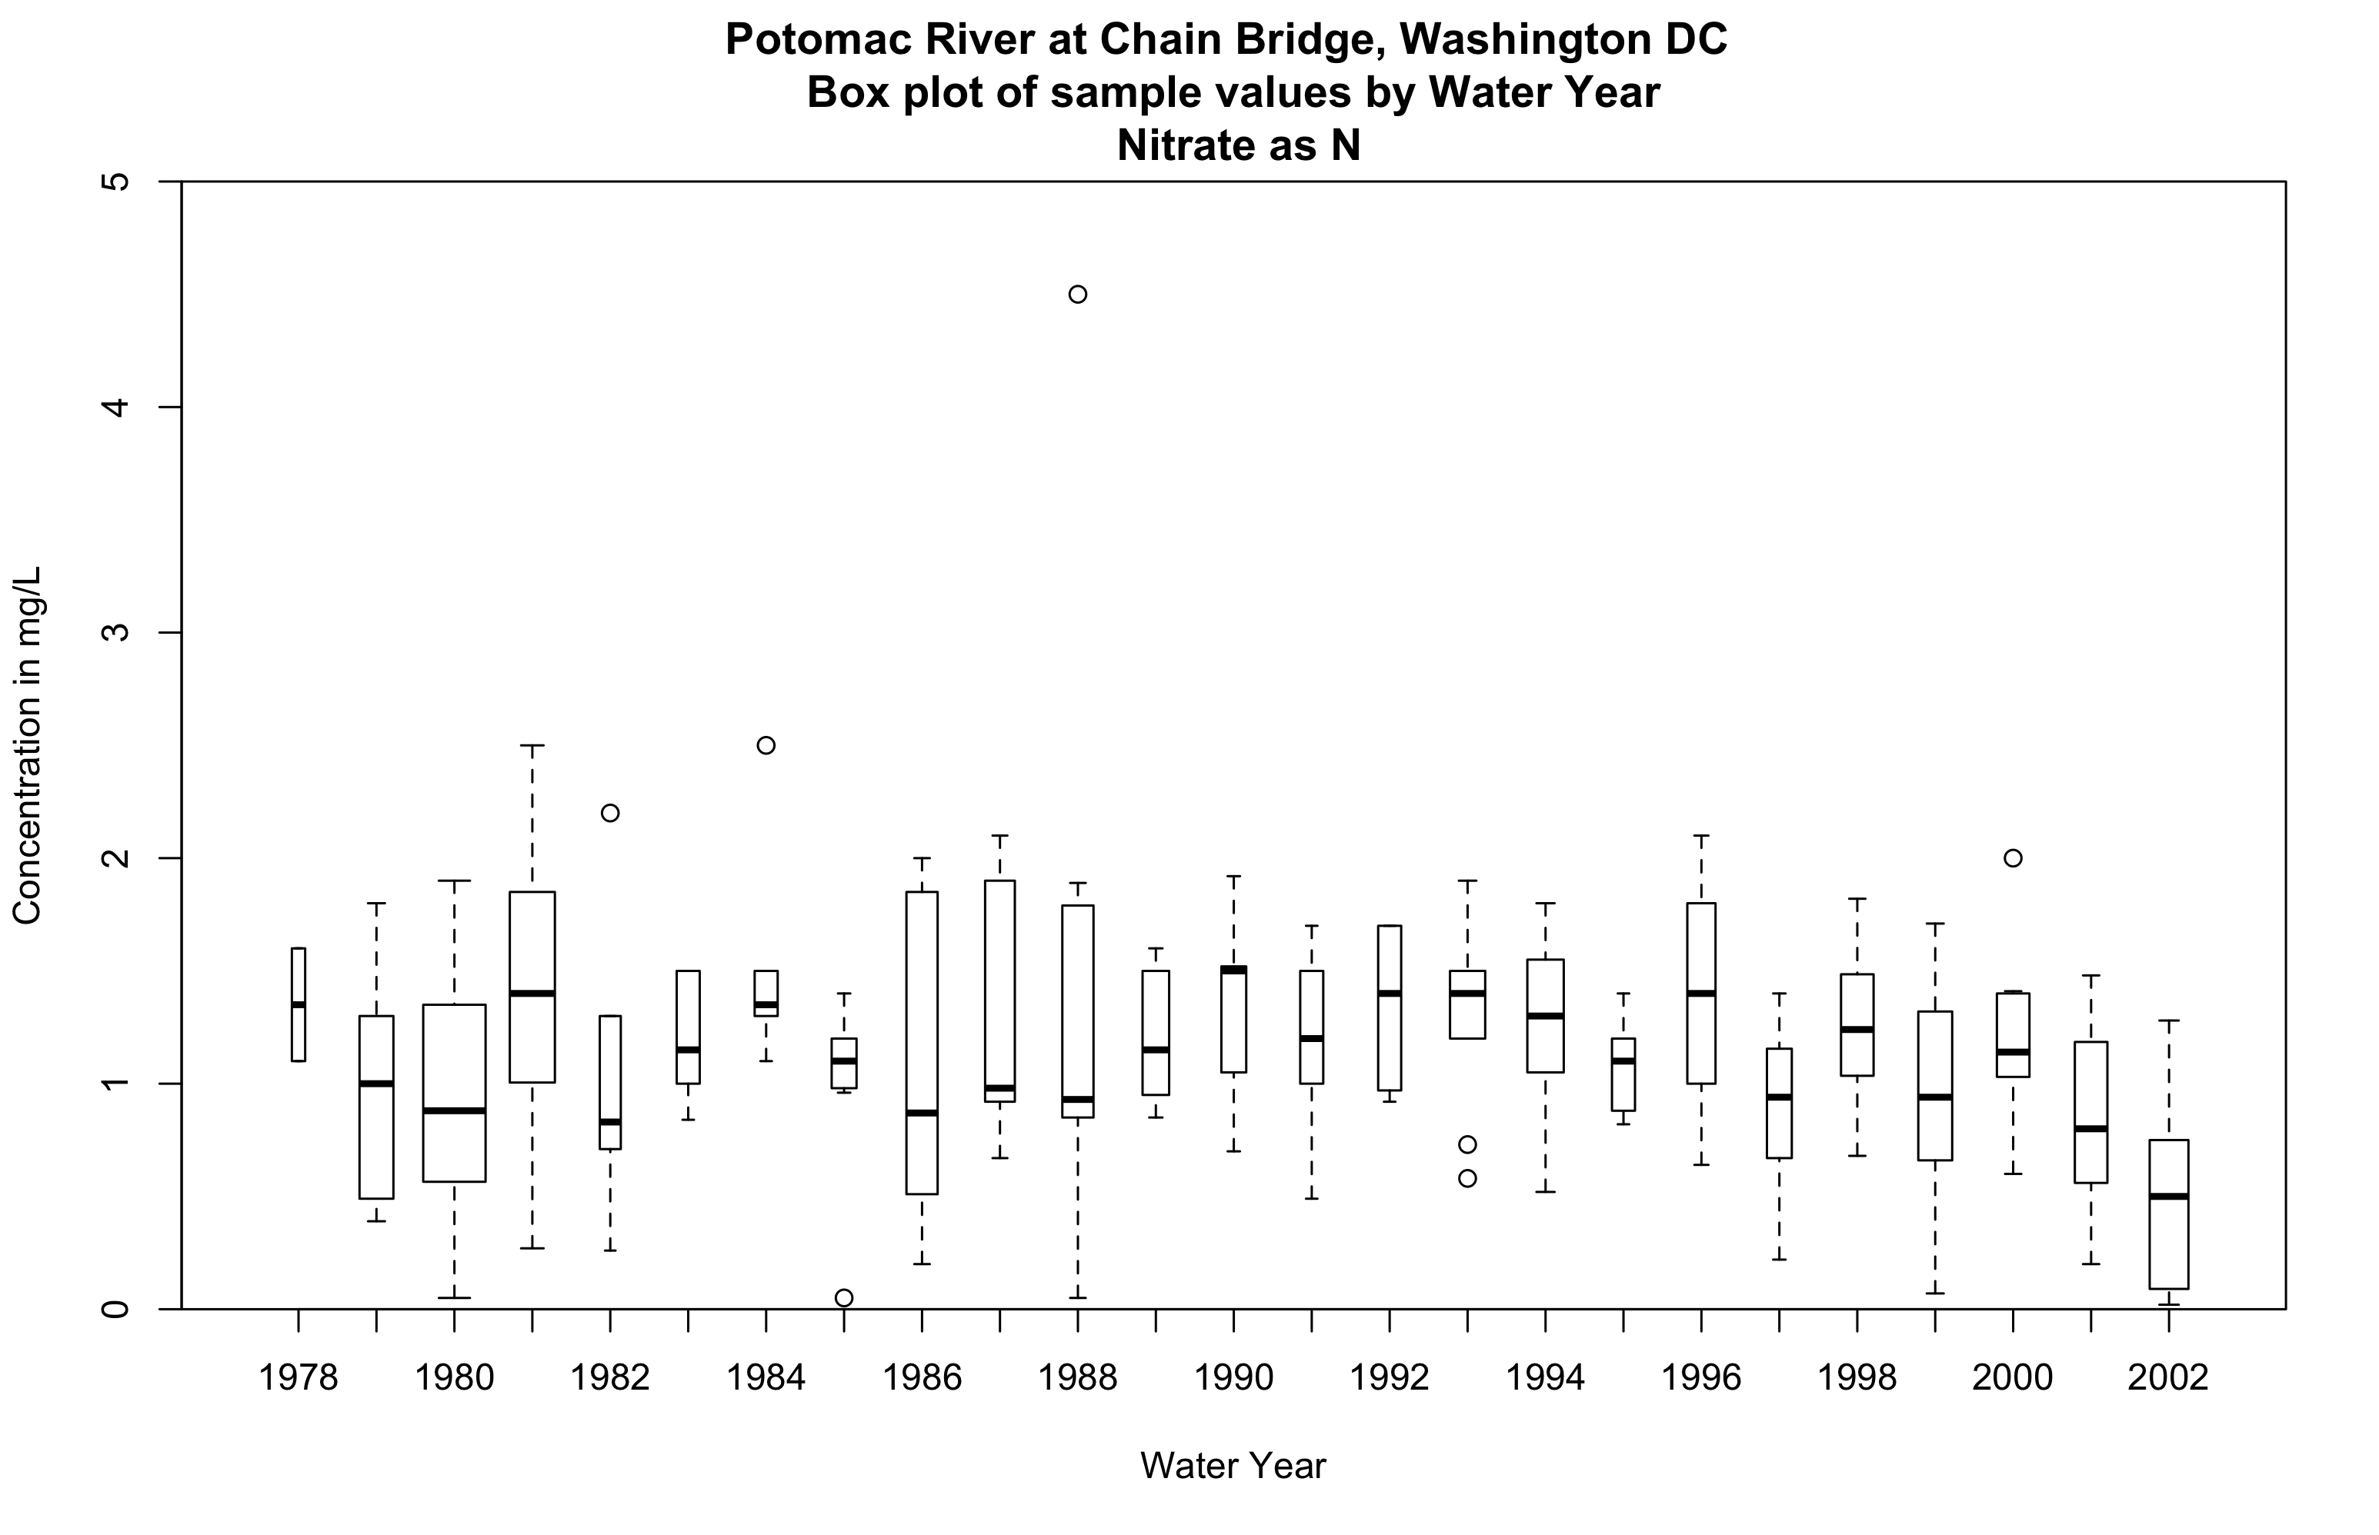
Declare
victory
Data through September 2002

Slide 5
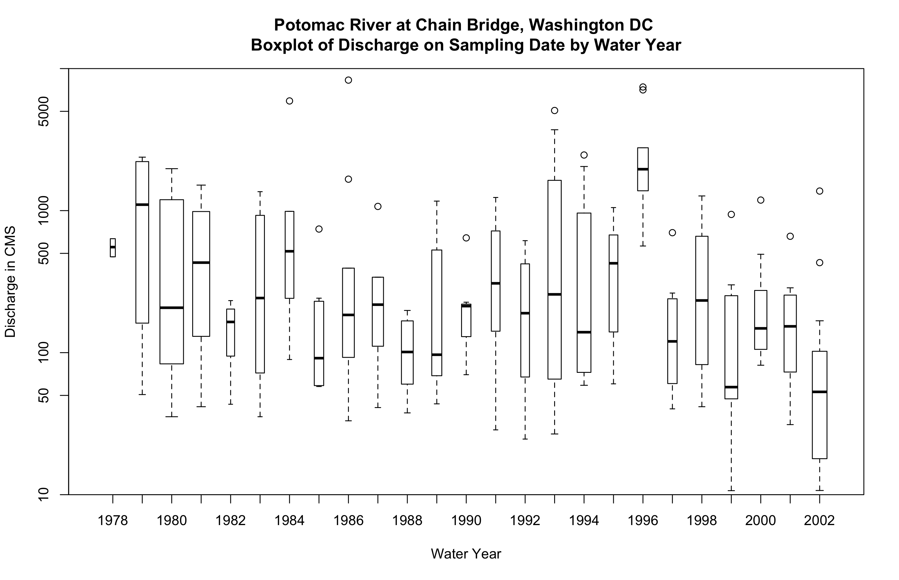

Slide 6
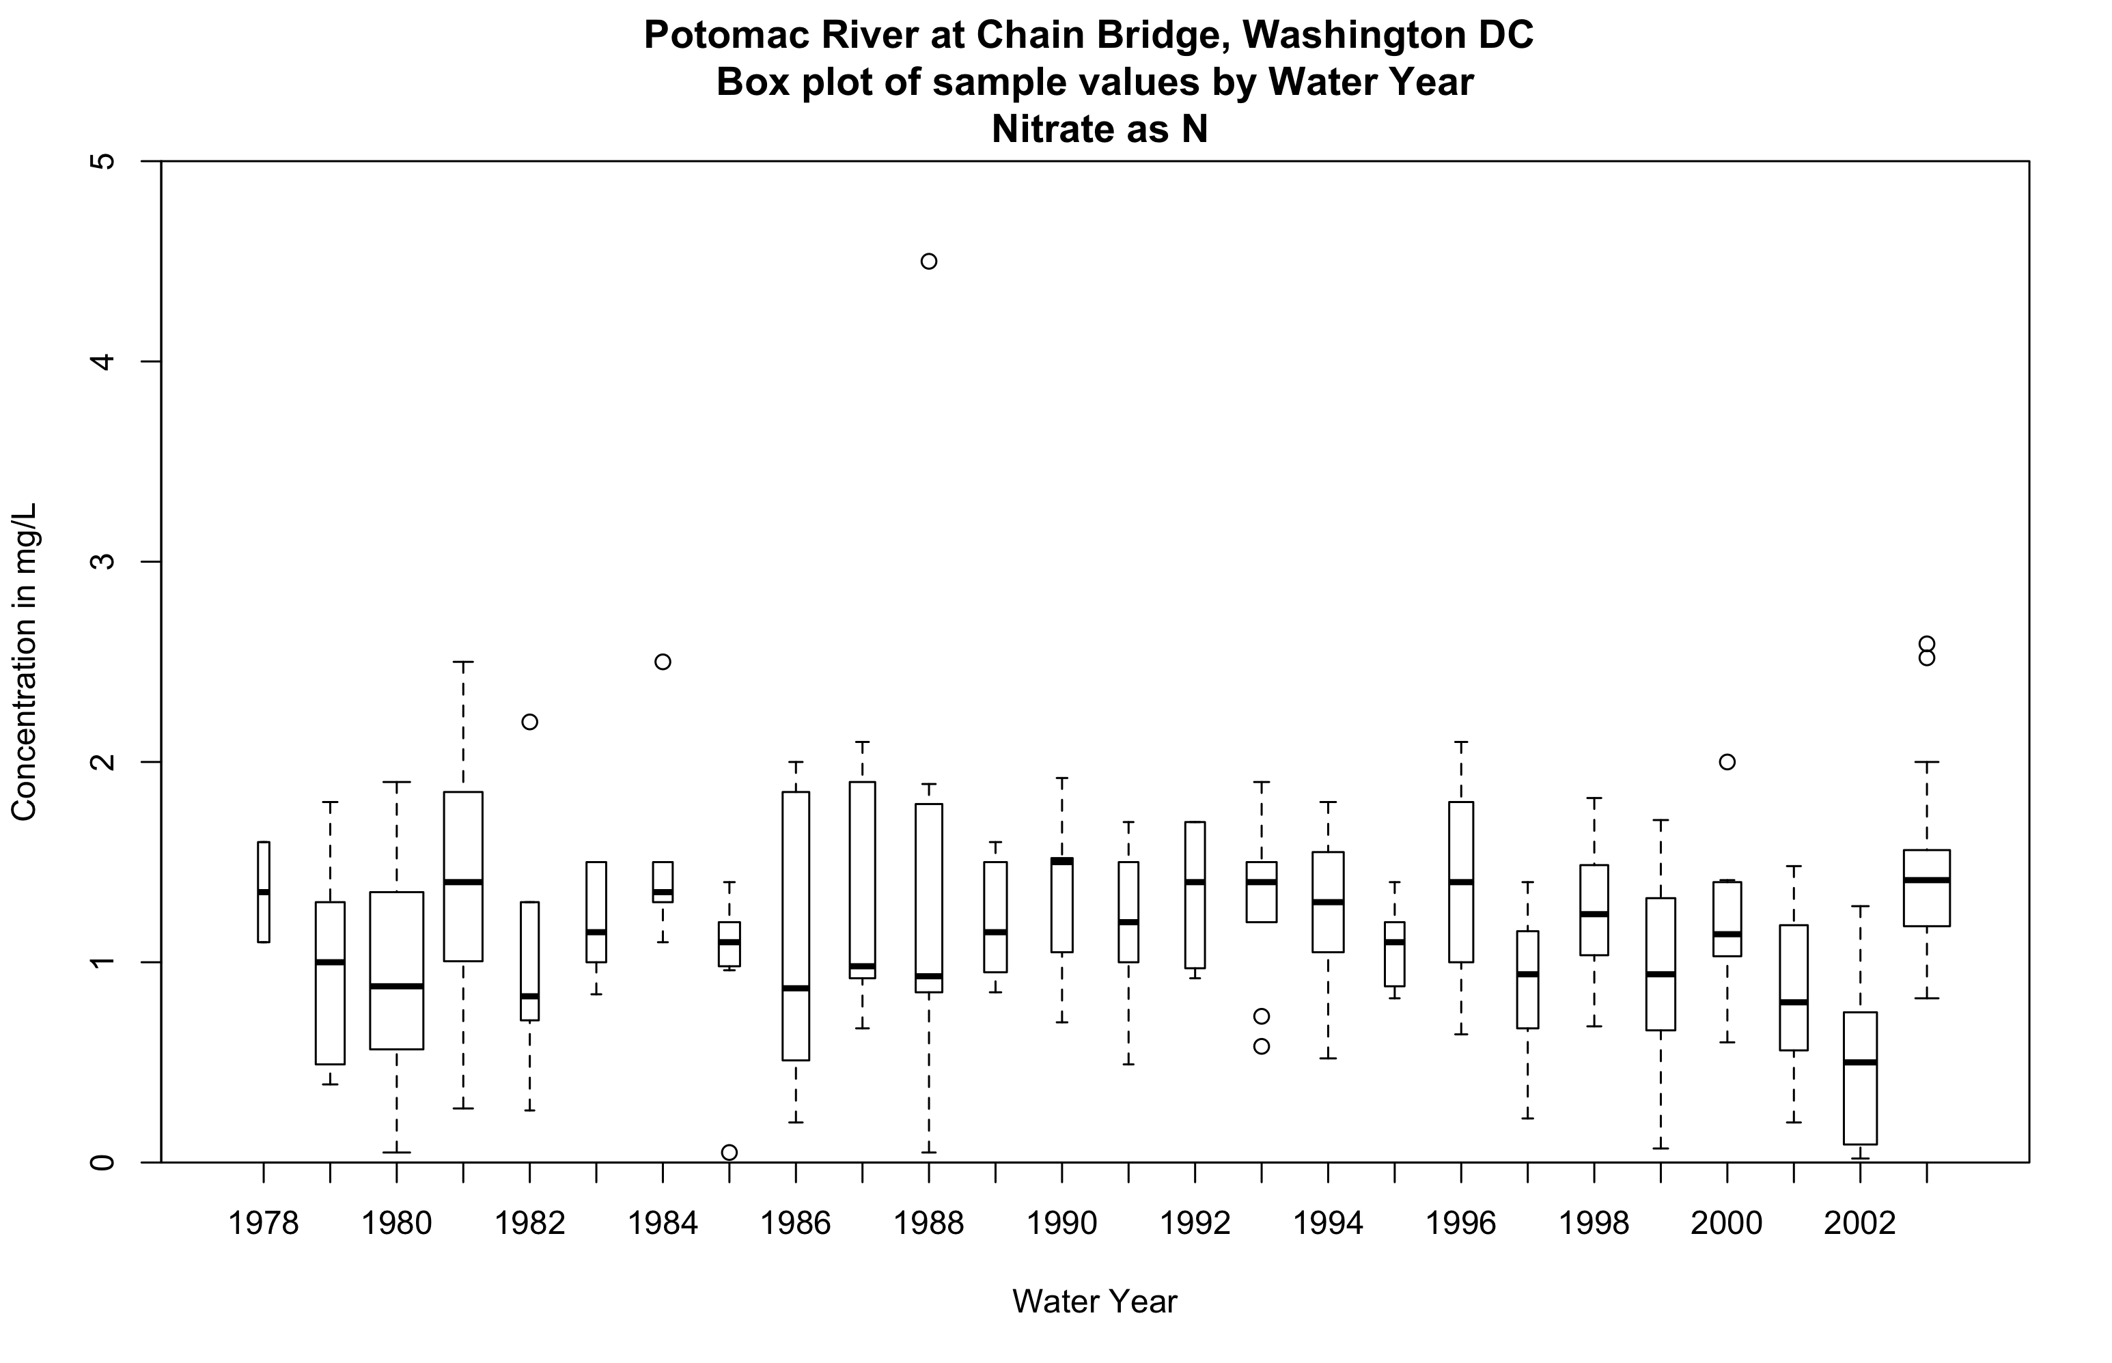
The agony of defeat
Data through September 2003

Slide 7
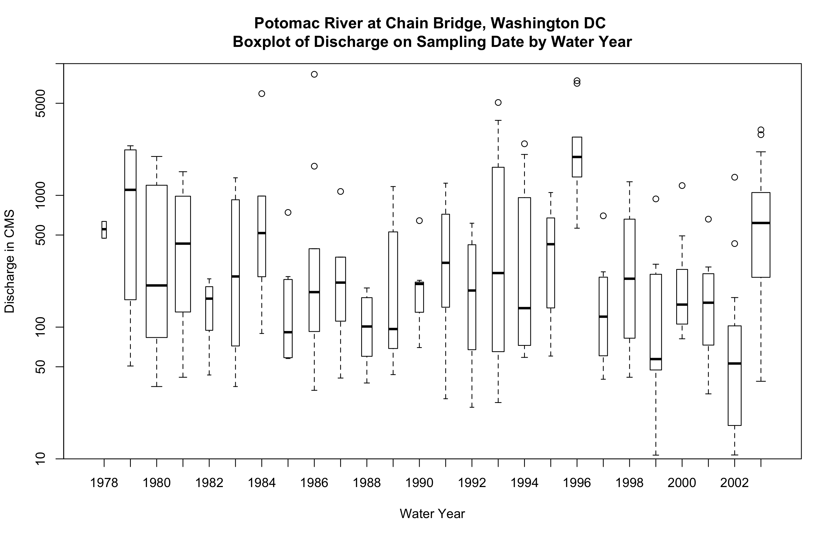

Slide 8
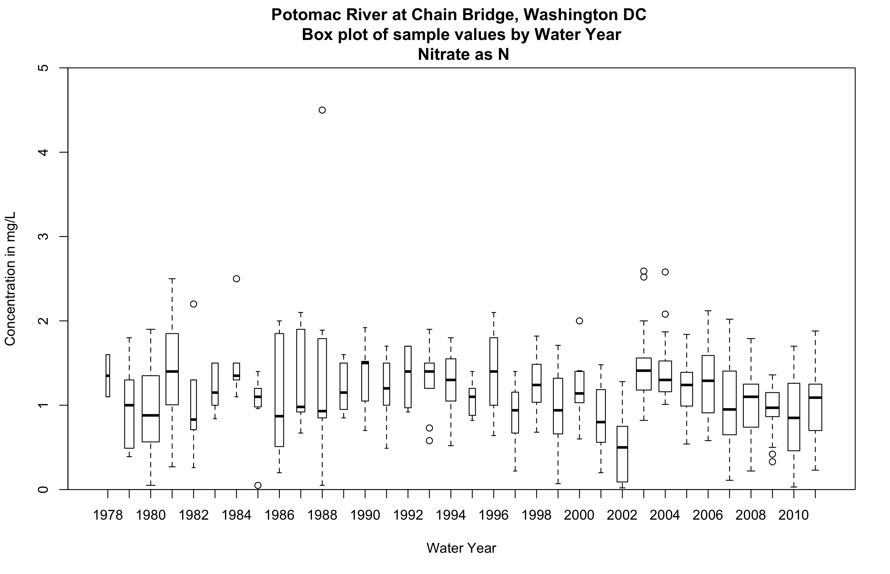
Data through September 2011

Slide 9
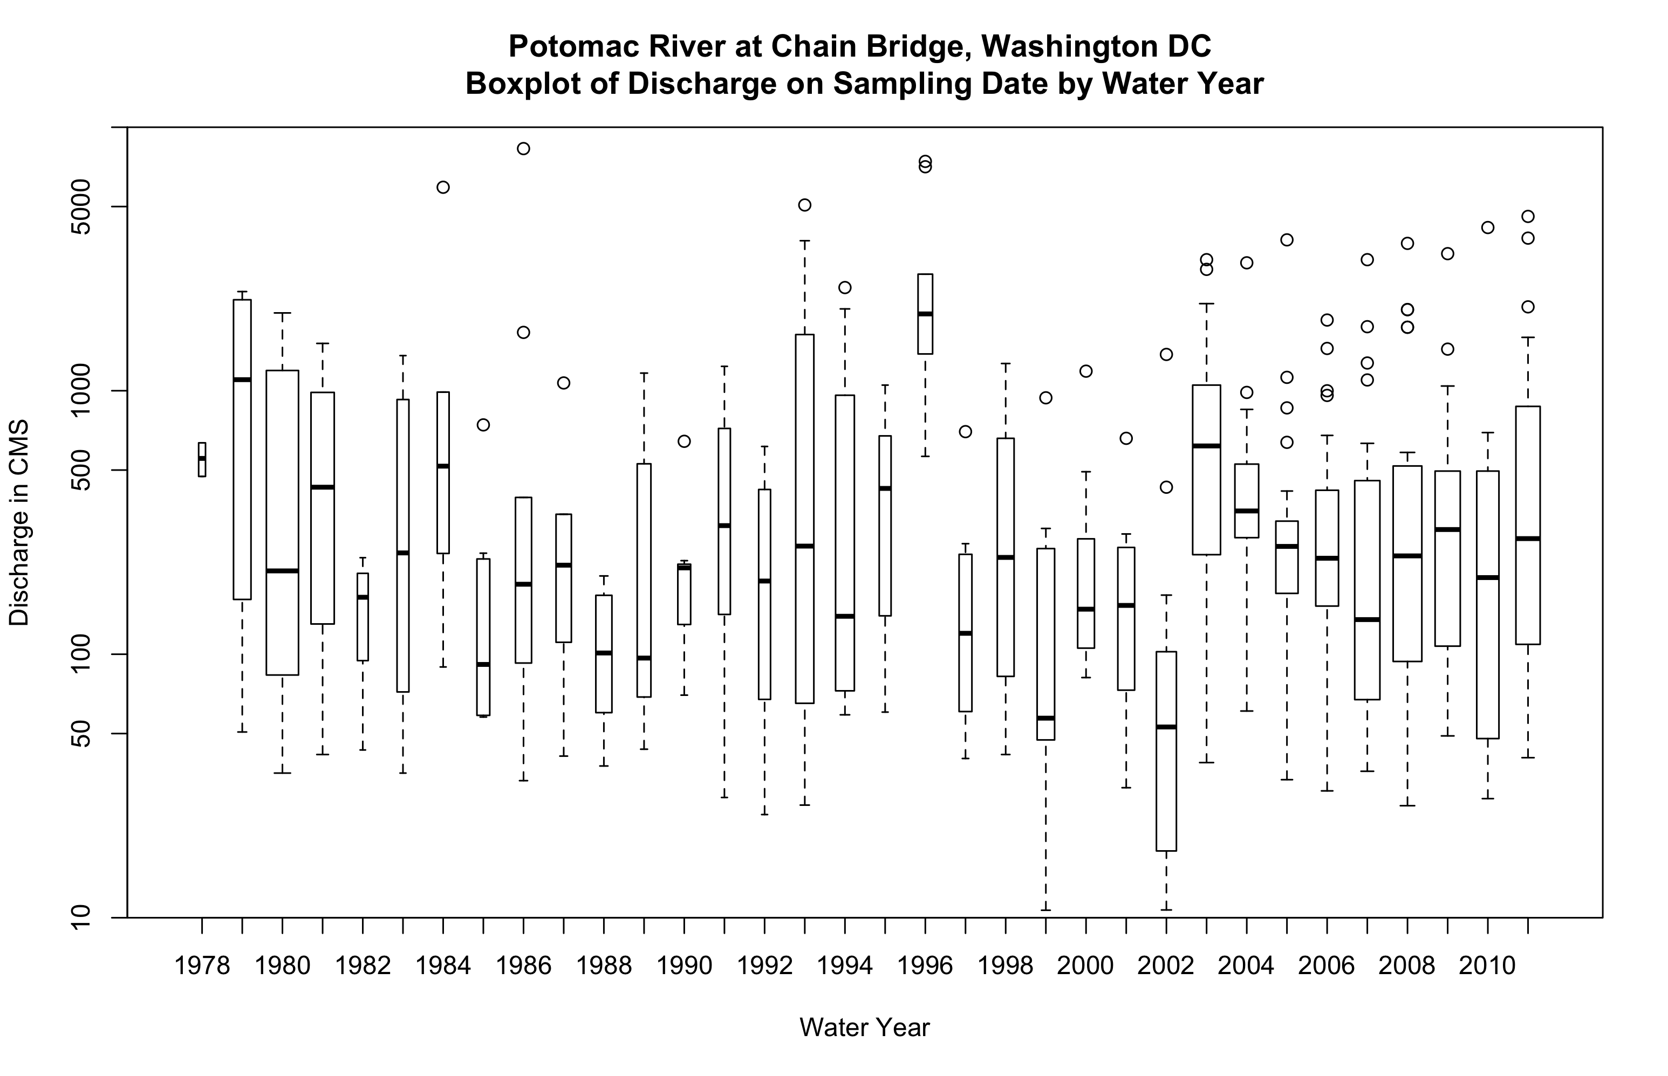

Slide 10
What needs motivated WRTDS?
Let the data inform the statistical model. No mathematical straight-jacket!!
Estimate both concentration & flux.
Estimate the actual history but also a flow-normalized history.
Try to resolve a serious flux-bias problem.
Be quantitative but also exploratory.
Focus on description and understanding not on statistical significance. Like economic and social time series.

Slide 11
EGRET overview
Ingest water quality sample data, daily streamflow data, and meta data from USGS Web services or from user-supplied files
Sub-systems: WRTDS for river water quality data analysis and flowHistory for analysis of streamflow alone
Goal: Exploration of the data to describe the evolving hydrologic system. Produce: graphs, summary statistics, understanding, and hypotheses.

Slide 12
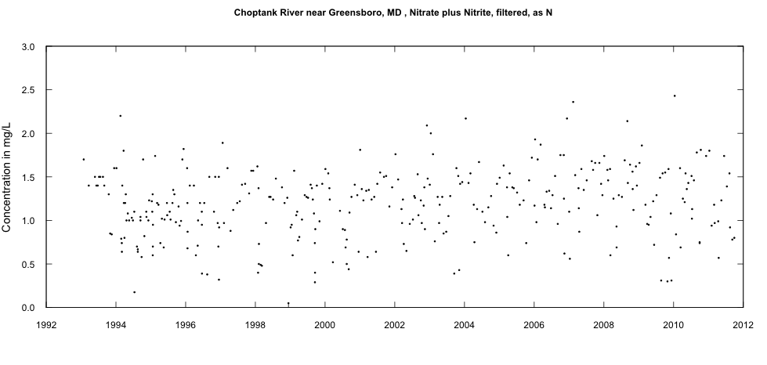
What’s the underlying idea of WRTDS?
Water quality is influenced by many factors, we need tools to sort out the factors
What’s going on here?

Slide 13
What’s the underlying idea of WRTDS?
Use the data and a simple, highly-flexible smoothing model, to compute for every day in the study period, an estimate of concentration and an estimate of flux.
The smoothing model expresses the behavior as a combination of influences:
Time trend
Discharge
Seasonal cycle
Random component

Slide 14
Locally Weighted Regression
For any location in time - discharge space (t and Q) we assume that concentration (c) follows this model
But the coefficients should be smoothly changing as we move through the space
Use weighted regression at many points in that space. The weight on each sample is determined by its “relevance” to that particular point in the space.

Slide 15
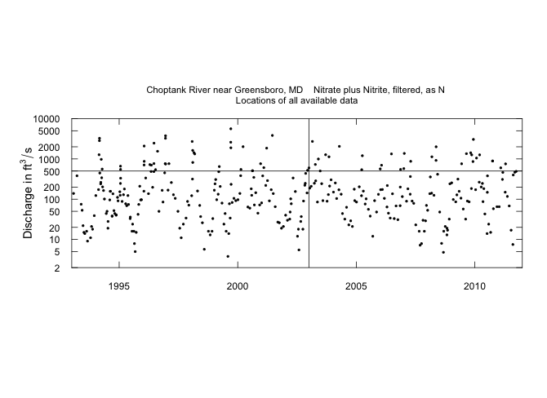
Every dot is a data point from 1993 to 2012
Let’s say we want to use the data to estimate the expected value of concentration for January 1, 2003 at Q=500 cfs

Slide 16
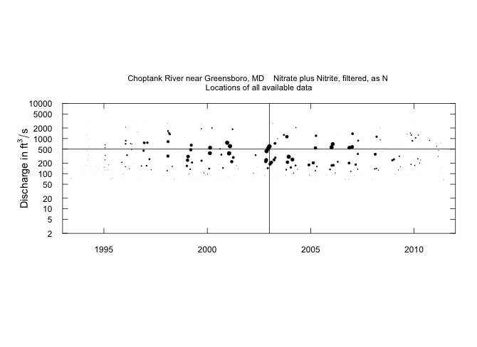
How do we set the weights for the regression?
These are the same points we just saw, but the radius of the dot is proportional to weight assigned to that point for purposes of estimating concentration for January 1, 2003 at Q=500 cfs
The weight depends on distance in: time, log discharge, and season from January 1, 2003 at Q = 500 cfs

Slide 17
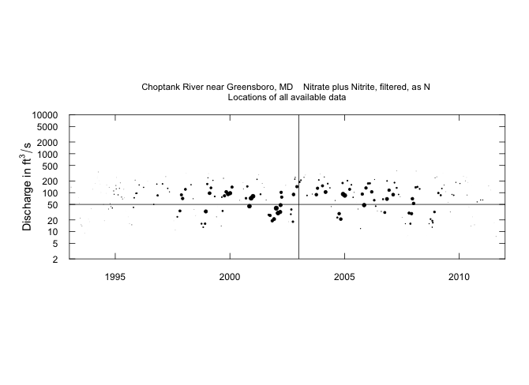
What if we wanted to make an estimate for January 1, 2003 but for Q = 50 cfs
Redo the weights for distance from that point

Slide 18
To organize the work, lets make estimates for a fine mesh of points in this space.
Over this space we will do it at 14 Q values and 177 time values, for a grid of 2,478 points.

Slide 19
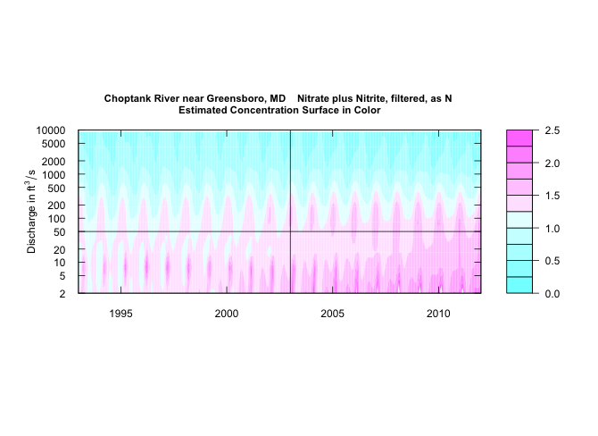
Here is the “surface” computed: It is the estimates of the Expected value of Concentration as a function of time and discharge

Slide 20
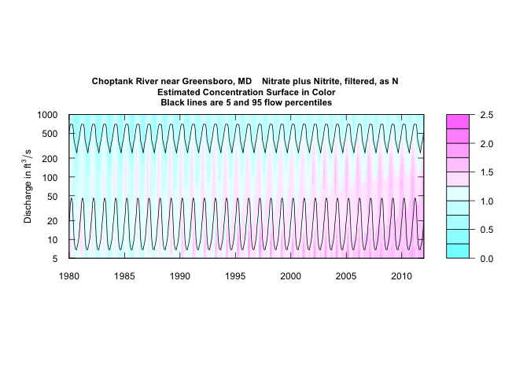
Here is the whole surface: 513 time values by 14 discharge values, for a total of 7,168 points
Added the black lines to illustrate the 5th and 95th percentiles on the seasonal flow duration curve

Slide 21
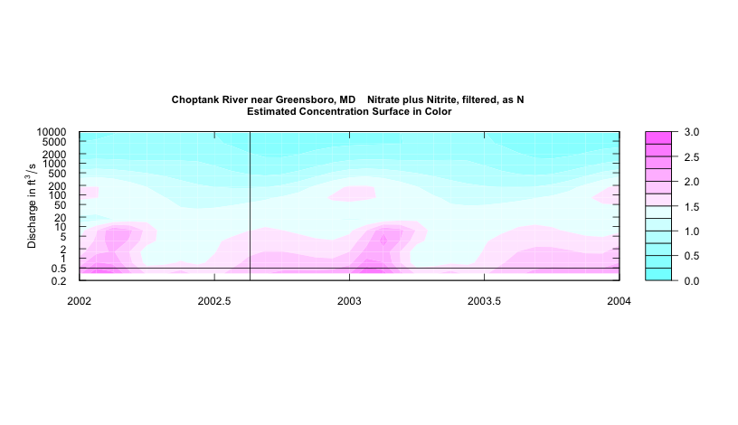
Look at a small part of this contour plot
Let’s look at August 20, 2002 (a serious drought), discharge was 0.49 cfs
Interpolation off this surface gives me an estimate of concentration for that day: 1.86 mg/L
For flux we compute: E(C) * Q to get 2.24 kg/day

Slide 22
EGRET does this process for each of the 11,718 days in the period of record.
It computes and stores:
11,718 estimated daily concentrations
11,718 estimated daily fluxes

Slide 23
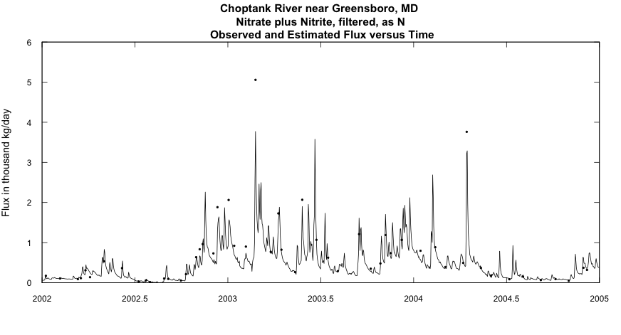
We can look at these flux estimates and compare them to the actual fluxes for the sampled days

Slide 24
Most of the difference between years is driven by the natural random variation in streamflow. Water years 2003 and 2004 were very wet.

Slide 25
The estimated concentrations and fluxes are important, particularly if one wants to understand the estuary’s response to inputs.
But, if we really want to understand “progress” or “lack of progress” in improving water quality in this watershed, we need to remove the effect of these random year-to-year variations driven by streamflow.
We do this through “flow-normalization”
How does that work?

Slide 26
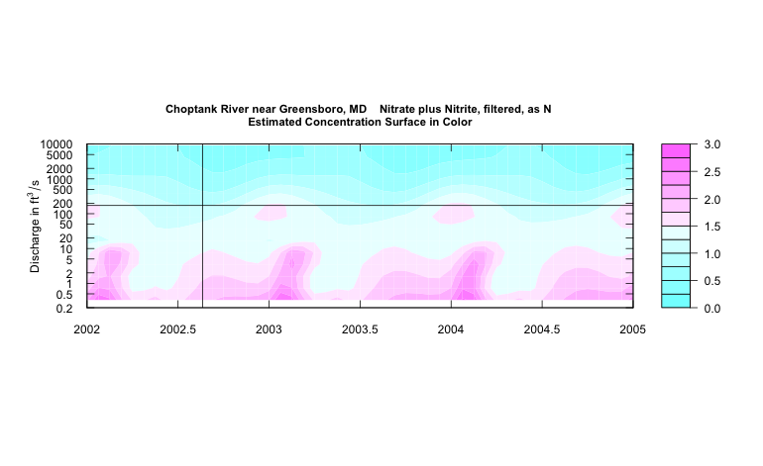
We can say that it is just as likely that Q could have been 172 cfs that day (it happens to be the Q from August 20, 2003) as the 0.49 cfs that happened August 20, 2002
The WRTDS estimate of concentration for that discharge, but based on the “behavior of the system” on August 20, 2002, is 1.0 mg/L
The flux for that discharge and that concentration comes to 431 kg/day

Slide 27
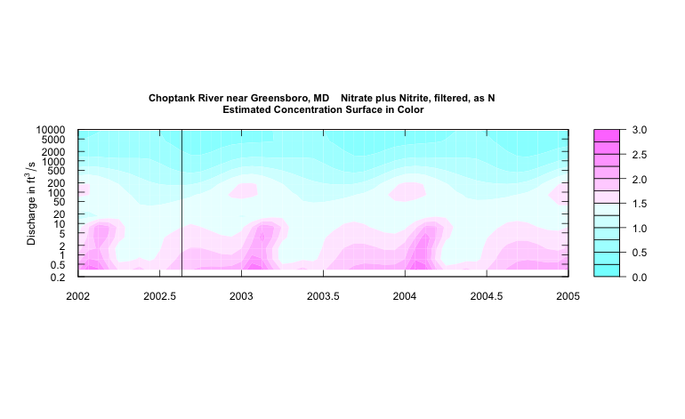
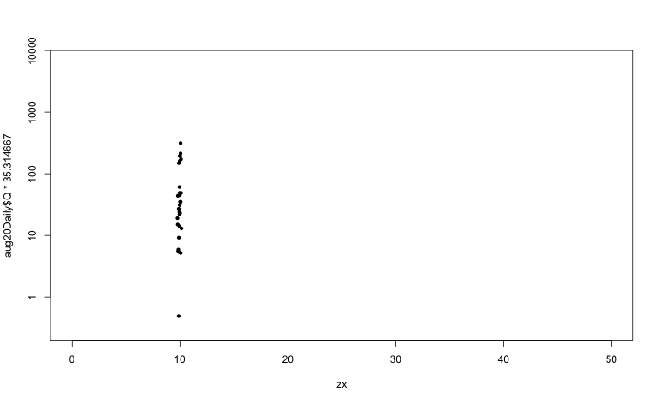
Let’s think of every Aug. 20 Q value we have seen as equally likely to have happened on Aug. 20, 2002 and estimate the concentration and flux we would have had on Aug. 20, 2002 with that Q
The mean of those concentrations is 1.31 mg/L, we call this the “flow-normalized concentration” for Aug. 20, 2002
The mean of the flux values is 164.4 kg/day, we call this the “flow-normalized flux” for Aug. 20, 2002

Slide 28
Flow-normalization allows us to remove the influence of the year to year variation in discharge (but not the natural seasonal variation in discharge)
The program computes, for every day:
The estimated concentration
The flow-normalized concentration
The estimated flux (flow * concentration)
The flow-normalized flux (by integrating flux over the frequency distribution of flow)

Slide 29
Now we have, for August 20, 2002
Estimated Concentration = 1.86 mg/L
Flow Normalized Concentration = 1.31 mg/L
Estimated Flux = 2.24 kg/day
Flow Normalized Flux = 164.4 kg/day
Now: do that process again and again for all 11,718 days in the record and store each of those four numbers for each day

Slide 30
It is assumed here that streamflow is stationary over the period of interest.
If I had a strong reason to believe that the past 34 years of August 20 streamflows is not a reasonable sample of the probability distribution of streamflows I can expect to see on this year’s August 20, then I should not use flow normalization.
Major new water controls (dams built or removed), or major changes in flow due to changes in water withdrawals, changes in impervious surface area, or groundwater drawdown, would require a modified approach.
I do not see climate change as sufficiently large at this time to invalidate this approach.

Slide 31
Different products for different purposes
Why all this complexity?
Concentration vs Flux
History vs Flow-normalized history

Slide 32

For understanding impact on the Bay ecosystem
Bay
Watershed
Streamgage
& Sampling
Location
Tidal
River
We want the flux history

Slide 33
For understanding progress in the watershed
Bay
Watershed
Streamgage
& Sampling
Location
Tidal
River
We want the flow-normalized flux history

Slide 34
For understanding the changes in the rivers
Bay
Watershed
Streamgage
& Sampling
Location
Tidal
River
We want the concentration history

Slide 35
Let’s run an analysis
Read in data
Look at the data
Run the model in cross-validation mode and check quality of the fit
Compute the “surface” of the expected value of concentration as a function of time, discharge and season
Use that surface to produce the 4 daily time series:
Reports those results as graphs, tables, and change measures
Explore the data and the model

Slide 36
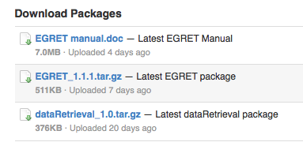
https://github.com/USGS-CIDA/WRTDS/blob/master/README.md
At the downloads page you will see something like this: this:
Download the tar.gz files them and then open R

Slide 37
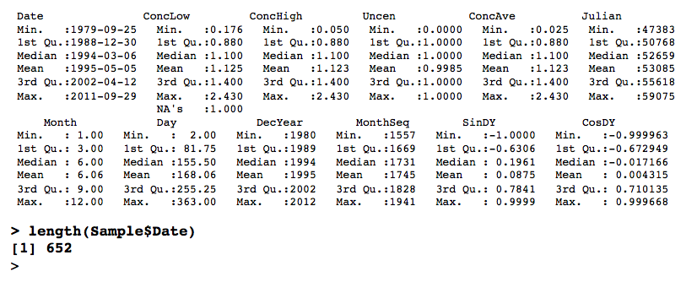
> library(dataRetrieval)
> library(EGRET)
> sta<-"01491000"
> param<-"00631"
> StartDate<-"1979-09-01"
> EndDate<-"2011-09-30"
> Sample<-getSampleData(sta,param,StartDate,EndDate)
> summary(Sample)

Slide 38
Treatment of “less than values”
In the uncensored case, let’s say concentration is 1.0
Then ConcLow = 1.0 and ConcHigh = 1.0
In the usual type of censored case, say concentration is reported as <1.0
Then ConcLow = NA and ConcHigh = 1.0
Because of censoring we use weighted “survival regression” (the function survreg in R) in place of ordinary weighted regression.
It views every data point as an interval:
In the first case the interval is (1.0 to 1.0)
In the second case the interval is (0.0 to 1.0)

Slide 39
Treatment of “less than values”
There is one more kind of case. The analyte of interest is the sum of two or more measured analytes.
Here is a real example for Total Nitrogen in the Susquehanna River, Maryland, April 27, 1988.
The rule is: Compute Total N as Ammonia plus organic N, unfiltered + Nitrate plus nitrite, filtered
They were reported as <0.2 and 0.9 mg/L respectively.
Then ConcLow = 0.9 and ConcHigh = 1.1
Conventional left-censored approach calls this (0, 1.1)
WRTDS calls this (0.9 to 1.1)

Slide 40
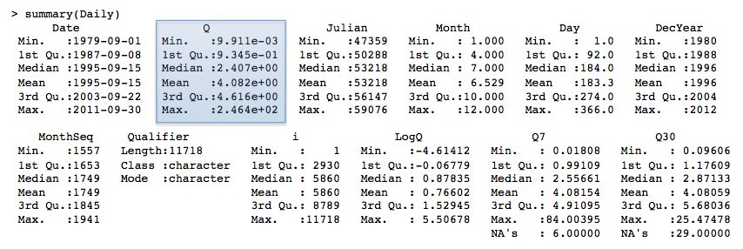
> Daily<-getDVData(sta,"00060",StartDate,EndDate)
There are 11718 data points, and 11718 days.
There are 0 zero flow days
If there are any zero discharge days, all days had 0 cfs added to the discharge value.
> length(Daily$Q)
[1] 11718

Slide 41
Reasons for the meta-data:
Knowing what data you have and where they came from
Putting labels on figures and tables
Putting a name on your saved workspaces, using abbreviations

Slide 42
> INFO<-getMetaData(sta,param)
Your site for streamflow data is 01491000 .
Your site name is CHOPTANK RIVER NEAR GREENSBORO, MD ,but you can modify this to a short name in a style you prefer.
This name will be used to label graphs and tables.
If you want the program to use the name given above, just do a carriage return, otherwise enter the preferred short name(no quotes):
Choptank River near Greensboro, MD

Slide 43
The latitude and longitude of the site are: 38.99719 , -75.78581 (degrees north and west).
The drainage area at this site is 113 square miles which is being stored as 292.6687 square kilometers.
It is helpful to set up a station abbreviation when doing multi-site studies, enter a unique id (three or four characters should work).
It is case sensitive. Even if you don't feel you need an abbreviation for your site you need to enter something (no quotes):
Chop

Slide 44
Your water quality data are for parameter number 00631 which has the name:' Nitrate plus nitrite, water, filtered, milligrams per liter as nitrogen '.
Typically you will want a shorter name to be used in graphs and tables. The suggested short name is:' Nitrate-nitrite '.
If you would like to change the short name, enter it here, otherwise just hit enter (no quotes):
Nitrate, filtered, as N

Slide 45
The units for the water quality data are: mg/l as N .
It is helpful to set up a constiuent abbreviation when doing multi-constituent studies, enter a unique id (three or four characters should work something like tn or tp or NO3).
It is case sensitive. Even if you don't feel you need an abbreviation you need to enter something (no quotes):
no3

Slide 46
This command works even if all of your data came from your own spreadsheet
Nothing in the system will work if you don’t have, at least:
A site name
A parameter name
A site abbreviation
A parameter abbreviation

Slide 47
Two more commands before we can start our analysis of the data
> Sample<-mergeReport()
Discharge Record is 11718 days long, which is 32 years
First day of the discharge record is 1979-09-01 and last day is 2011-09-30
The water quality record has 652 samples
The first sample is from 1979-09-25 and the last sample is from 2011-09-29
Discharge: Minimum, mean and maximum 0.00991 4.08 246
Concentration: Minimum, mean and maximum 0.05 1.1 2.4
Percentage of the sample values that are censored is 0.15 %

Slide 48
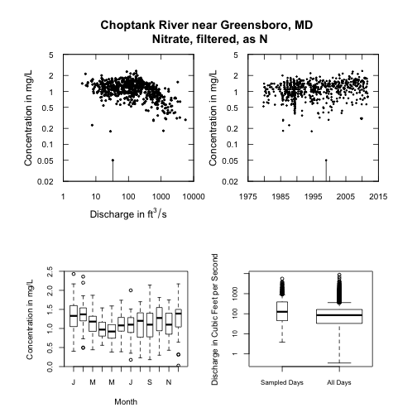
Let’s look at the data before we proceed, the function is:
> multiPlotDataOverview(qUnit=1)

Slide 49
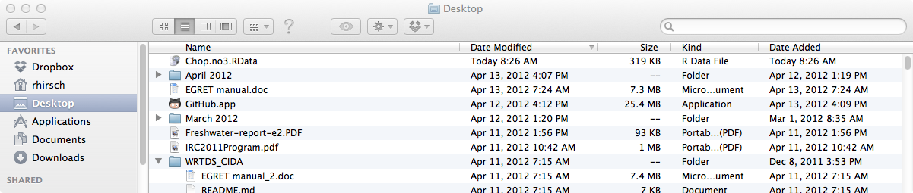
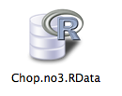
We’ve gone to all this effort, let’s save our work
> savePath<-"/Users/rhirsch/Desktop/"
> saveResults(savePath)
Save it over and over as you proceed and add results

Slide 50
We now have 3 data frames
Sample (652 rows, 14 columns)
Daily (11,718 rows, 12 columns)
INFO (1 row, 42 columns)

Slide 51
> modelEstimation()
Jack-knife cross-validation of model
Sets up the grid in ln(Q) and time
Estimates surfaces for log(C), standard error and Concentration
Estimates the daily values from these surfaces (Conc, Flux, FNConc, FNFlux)
Creates a summary of monthly results
Various options are possible here, for window widths and minimum data requirements

Slide 52
Setting up the “Period of Analysis”
Could be water year
Could be calendar year
Could be April-May-June
Could be Dec-Jan-Feb-Mar
Could be only May
paStart = calendar month that starts the Period
paLong = length of Period, in months

Slide 53
Setting up the “Period of Analysis”
paStart paLong
Could be water year 10 12
Could be calendar year 1 12
Could be April-May-June 4 3
Could be Dec-Jan-Feb-Mar 12 4
Could be only May 5 1
paStart = calendar month that starts the Period
paLong = length of Period, in months

Slide 54
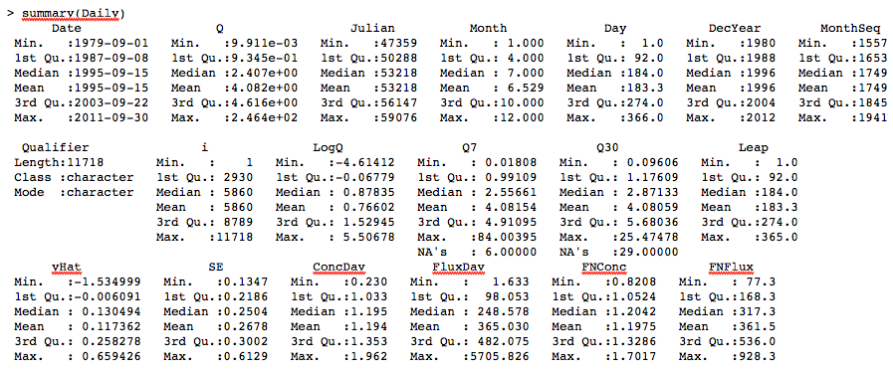
Now what is in Daily?

Slide 55
Compute AnnualResults
> AnnualResults<-setupYears(paLong=12,paStart=1)
> AnnualResults<-setupYears()

Slide 56
We now have 5 data frames
Sample (652 rows, 17 columns)
Daily (11,718 rows, 19 columns)
INFO (1 row, 53 columns)
MonthlyResults (385 rows, 7 colmuns)
AnnualResults (32 rows, 8 columns)
And a matrix surfaces 14*529*3

Slide 57
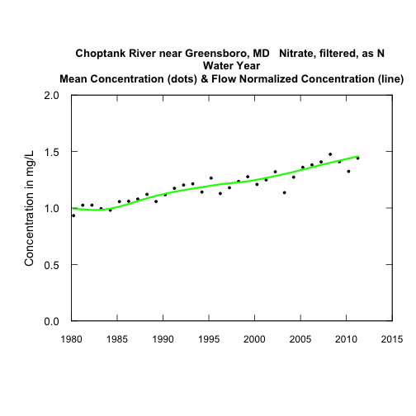
> plotConcHist(1980,2012)

Slide 58
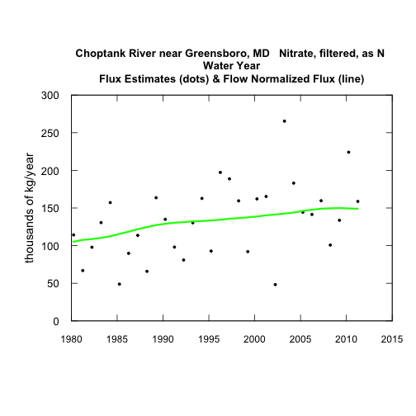
> plotFluxHist(1980,2012,fluxUnit=8)

Slide 59
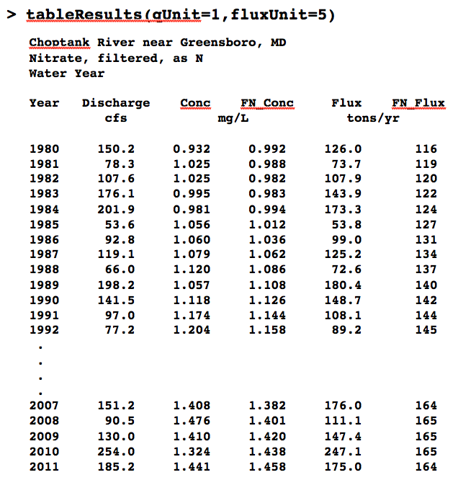

Slide 60
> tableChange(fluxUnit=5,yearPoints=c(1980,1995,2011))

Slide 61
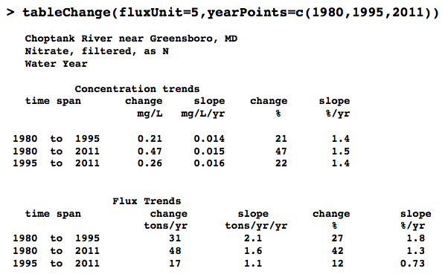

Slide 62
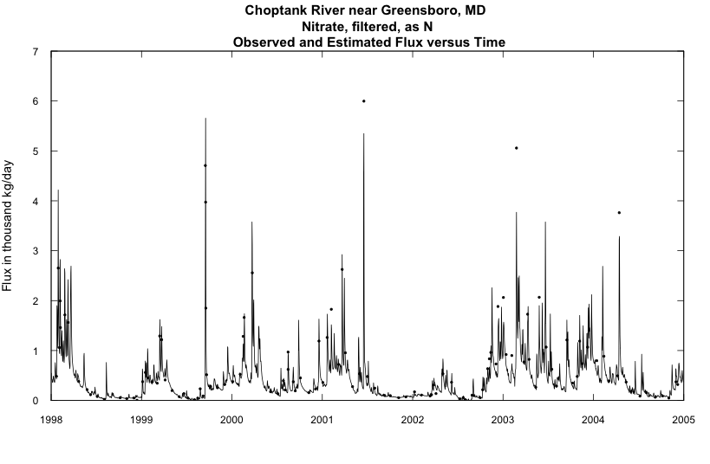
Looking at the WRTDS model - Diagnostics
> plotFluxTimeDaily(1998,2005)

Slide 63
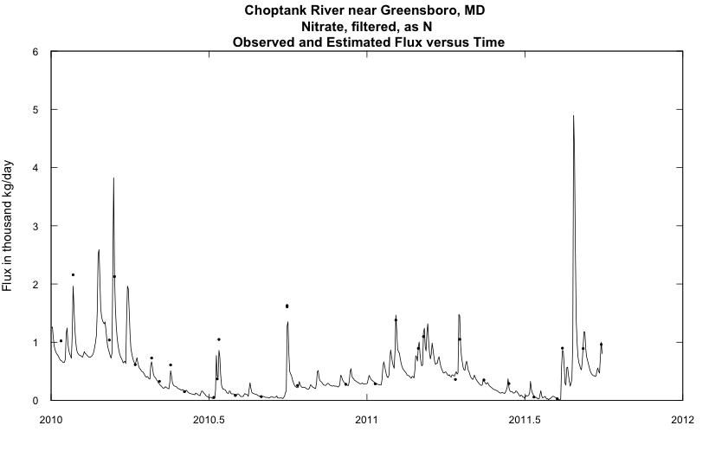
> plotFluxTimeDaily(2010,2011.75)

Slide 64
More Diagnostics – Looking at quality of fit and flux bias
EGRET computes a flux bias statistic which is computed from the Sample data frame, using the Jack-Knife estimates of concentration. The statistic is:
Mean(Sampled day flux estimates) – Mean(Sampled day flux values)
Mean(Sampled day flux values)
For example a value of 0.25 would mean that the estimates are, on average, 25% too high.
Because of censoring we don’t know the Sampled day flux values exactly, but we can put bounds on them.
It is rare that the censoring matters to this statistic.

Slide 65
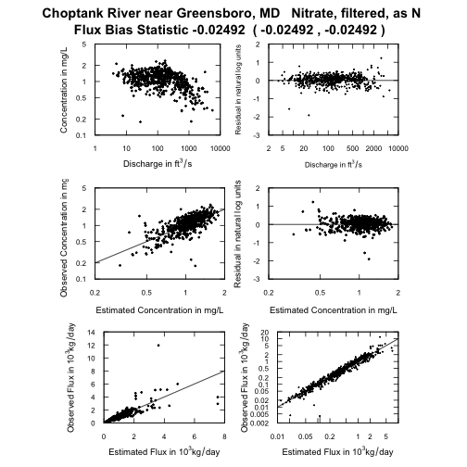
> fluxBiasMulti(qUnit=1,fluxUnit=4)
For this data set flux bias statistic looks fine.
Average estimates are about 2.5% below average observed.
This is very acceptable.

Slide 66
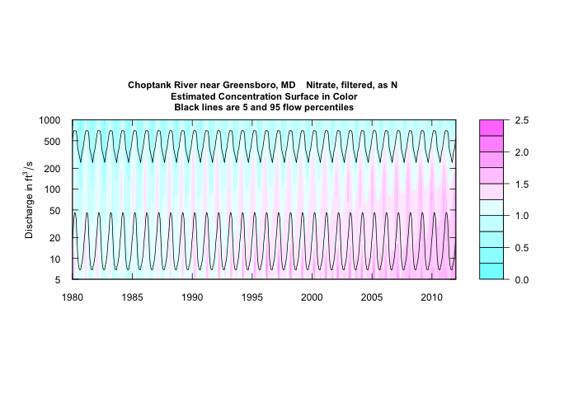
So, what does the model “look like”? How has the system’s behavior changed over time?
> plotContours(1980,2012,5,1000,qUnit=1,contourLevels=seq(0,2.5,0.25))

Slide 67
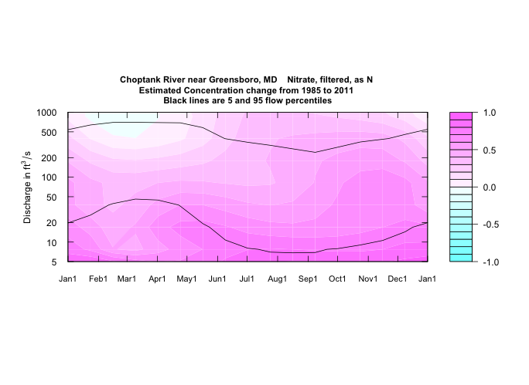
> plotDiffContours(1985,2011,5,1000,qUnit=1,maxDiff=1.0)
Increases at almost all seasons and flows, greatest increases are at lower flows in the months June through January
Very small improvement at very high flows in January through April
Now, can we look at the data without all the “statistical tricks?”

Slide 68
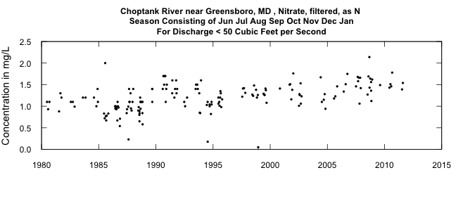
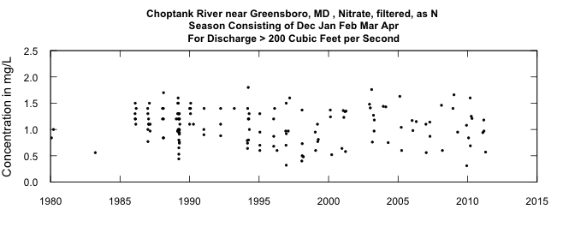
> plotConcTime(qUnit=1,qUpper=50,paLong=8,paStart=6,concMax=2.5)
> plotConcTime(qUnit=1,qLower=200,paLong=5,paStart=12,concMax=2.5)

Slide 69
Look at a different data set: Total Phosphorous Susquehanna River at Conowingo, MD
Single largest river input to Chesapeake Bay
Sampling at Conowingo Dam, reservoir capacity getting nearly full of sediment

Slide 70
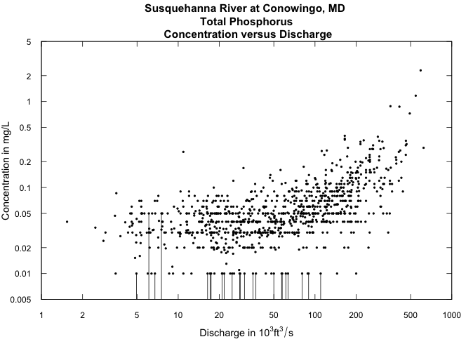
> plotLogConcQ(concMin=0.005,qUnit=3)

Slide 71
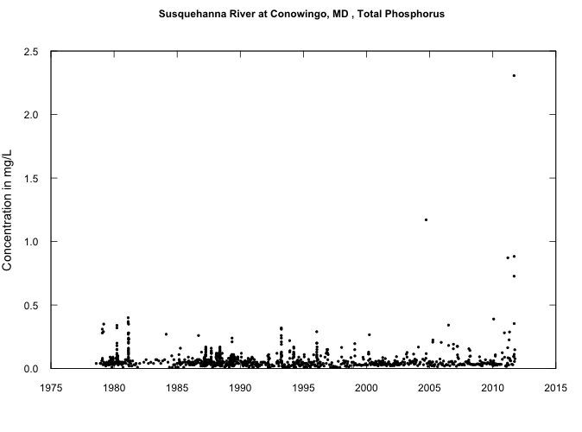
> plotConcTime()

Slide 72
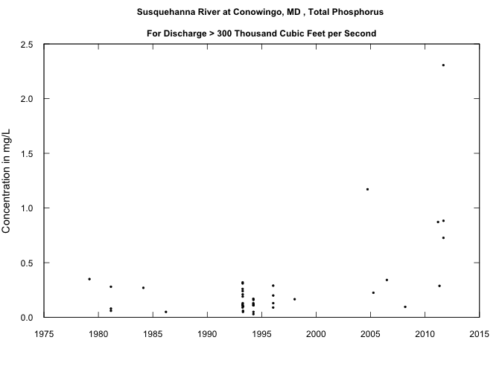
> plotConcTime(concMax=2.5,qLower=300,qUnit=3)
Before 2000 all were <0.4 mg/L
After 2000 44% were <0.4 mg/L

Slide 73
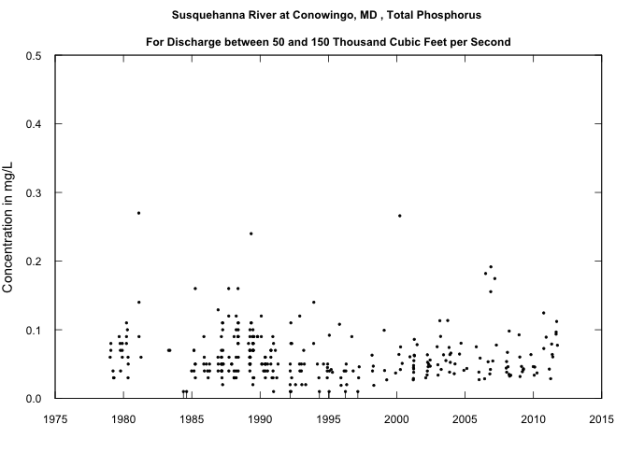
> plotConcTime(concMax=0.5,qLower=50,qUpper=150,qUnit=3)

Slide 74
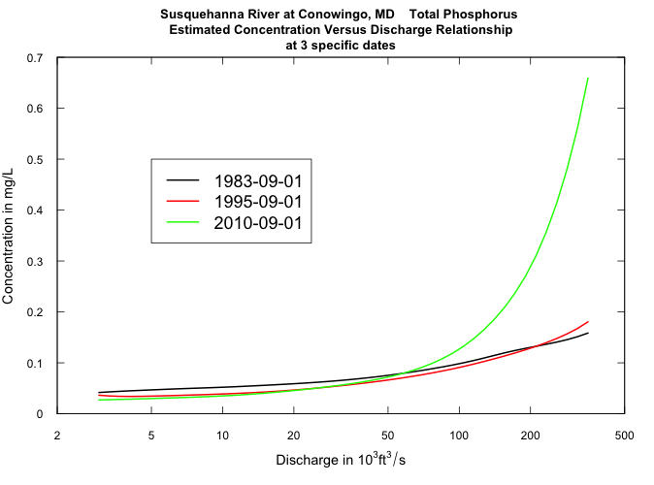
> plotConcQSmooth("1983-09-01","1995-09-01","2010-09-01",qLow=3,qHigh=350, qUnit=3,legendLeft=5,legendTop=0.5)

Slide 75
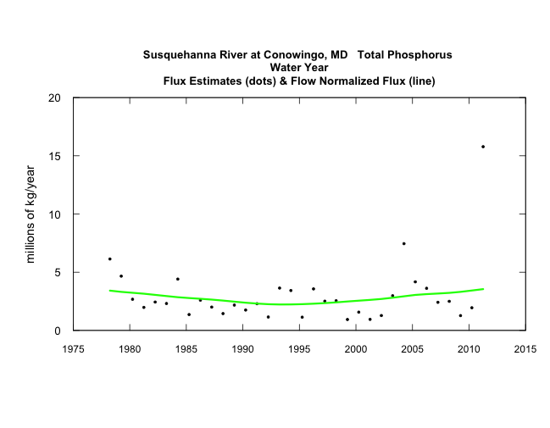
> plotFluxHist(1975,2012)

Slide 76
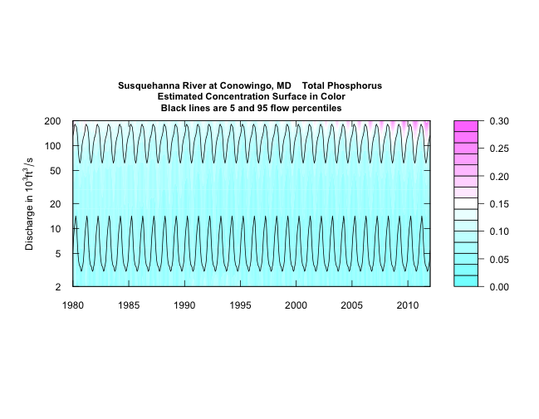
> plotContours(1980,2012,2,200,qUnit=3,contourLevels=seq(0,0.3,0.02))

Slide 77
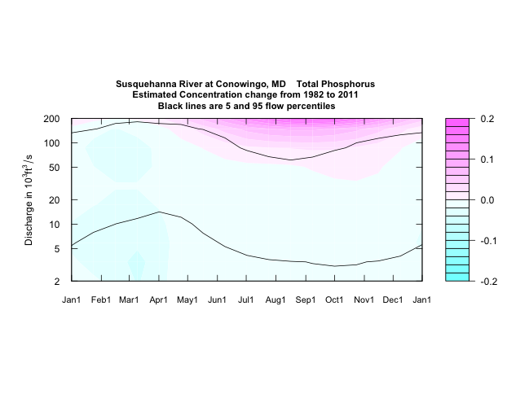
> plotDiffContours(1982,2011,2,200,qUnit=3,maxDiff=0.2)
Over most flows and most seasons there has been little change between 1982 and 2011
But, for discharge above about 100,000 cfs there are substantial increases, especially in the tropical storm season.
Slight improvement indicated in winter at most flows.

Slide 78
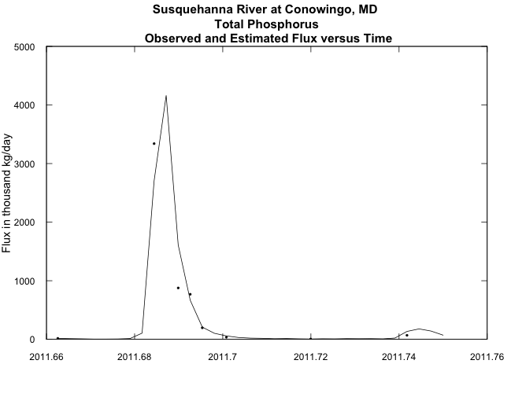
> plotFluxTimeDaily(2011.66,2011.75)
September, 2011

Slide 79
Because we have the Daily data frame, with an estimated flux for every day of the record, we can look at it to calculate things like:
Tropical Storm Lee flux, about 10,600 tons
Water Year 2011 flux, about 17,400 tons
Average flux over past decade about 4,800 tons/year
Average flux over entire 34 year record about 3,300 tons/year
Tropical Storm Lee carried
12% of 2011 streamflow and 61% of 2011 Total Phosphorus
1.8% of the past decade’s streamflow and 22% of the Total Phosphorus
0.6% of the streamflow of the 34 years and 9% of the Total Phosphorus

Slide 80
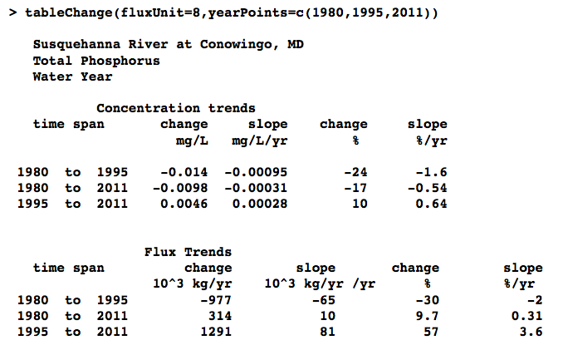

Slide 81
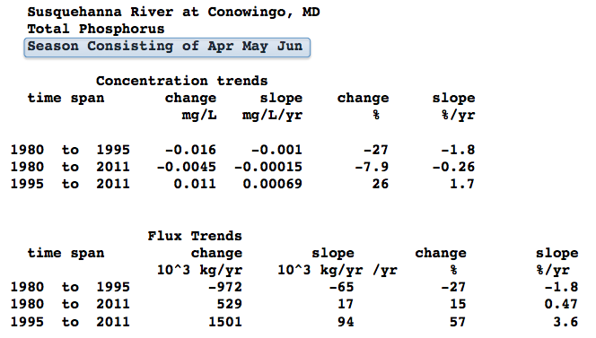
> AnnualResults<-setupYears(paLong=3,paStart=4)
> tableChange(fluxUnit=8,yearPoints=c(1980,1995,2011))

Slide 82
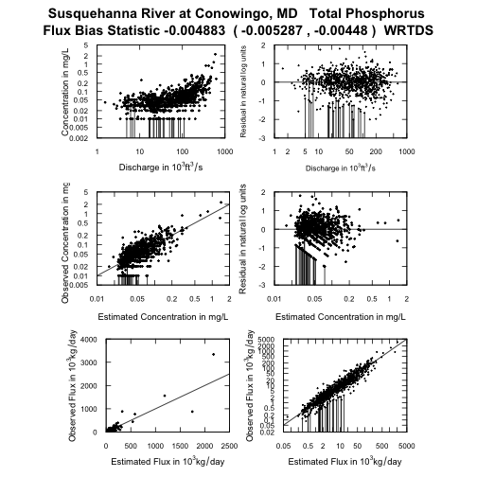
> fluxBiasMulti(qUnit=3, fluxUnit=4, moreTitle="WRTDS")
A short aside about the “flux bias” problem
Models such as WRTDS or LOADEST are fit in log space but used in “real” space.
None of them should be used without checking that the model behavior is reasonably close to actual behavior.

Slide 83
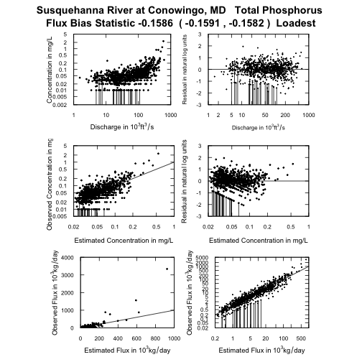
Average flux bias for Loadest on sampled days is about -16%
Notice the U shape of residuals versus predicted
Notice the severe under-prediction of flux on the highest flux days

Slide 84
Let’s move to the corn belt:
Iowa River at Wapello, IA
Total Nitrogen

Slide 85
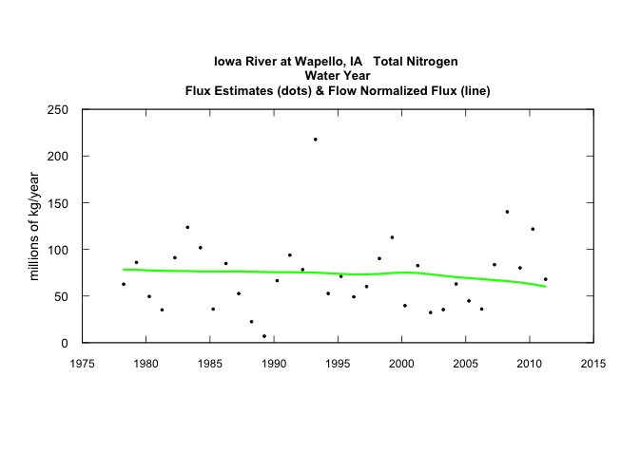
Pretty good news, Flow Normalized Flux
1980 – 1993 decreasing about 0.2%/year
1993 – 2011 decreasing about 1.1%/year

Slide 86

> flowDuration()
Flow Duration for Iowa River at Wapello, IA
Flow duration is based on full year
Discharge units are Cubic Meters per Second
min 5% 10% 25% 50% 75% 90% 95% max
16.4 44.5 68.0 104.5 194.0 390.8 690.9 900.5 4870.5
> plotContours(1978,2012,20,2000,contourLevels=seq(0,12,2))

Slide 87

> plotDiffContours(1993,2011,20,2000,maxDiff=4)
Concentrations decreasing at high discharge throughout the year
Biggest declines around May and June
Some increase at low flows from February through June

Slide 88

> plotConcQSmooth("1993-04-01","2011-04-01",NA,qLow=100,qHigh=1000)
Some good news here, reduced TN concentrations at high flows in the Spring

Slide 89

> plotConcQSmooth("1993-04-01","2011-04-01",NA,qLow=20,qHigh=5000)
An example of “EGRET abuse”

Slide 90

> plotConcTime(qLower=500,paLong=4,paStart=4)

Slide 91

Moving to the western edge of the corn belt – the Missouri River at Hermann, MO
> tableChange(fluxUnit=9,yearPoints=c(1980,2000,2011))

Slide 92
Moving to the western edge of the corn belt – the Missouri River at Hermann, MO
> tableChange(fluxUnit=9,yearPoints=c(1980,2000,2011))

Slide 93


Gulf Hypoxia concerns are focused on May flux (rather than annual). What’s been the trend in May flux.
> AnnualResults<-setupYears(paLong=12,paStart=10)
> plotFluxHist(1980,2012)
> AnnualResults<-setupYears(paLong=1,paStart=5)
> plotFluxHist(1980,2012)
Annual flux keeps rising, but May flux seems flat, suggesting that the flux is getting more “spread out” over the course of the year. The role of groundwater?

Slide 94

> plotConcQSmooth("1985-05-01","2009-05-01",NA,qLow=50,qHigh=200,qUnit=3)

Slide 95

> plotContours(1979,2012,20,500,qUnit=3,contourLevels=seq(0,6,0.5))

Slide 96

> plotDiffContours(1982,2011,50,200,qUnit=3,maxDiff=2)

Slide 97



Slide 98

Sometimes what doesn’t work well is highly informative and suggests the need for a more complex model. > plotFluxTimeDaily(2006,2012)
What was special about 2011 for the Missouri River?

Slide 99

One last example
It doesn’t take a rocket scientist to see that chloride decreases with flow, has increased with time, and is highest in the winter
But is there more to the story?

Slide 100


Slide 101


The changes are not confined to the winter months
> AnnualResults<-setupYears(paLong=3,paStart=1)
> plotConcHist(1970,2010)
> AnnualResults<-setupYears(paLong=5,paStart=7)
> plotConcHist(1970,2010,concMax=200)

Slide 102

> flowDuration()
Flow Duration for Milwaukee River at Milwaukee, WI
Flow duration is based on full year
Discharge units are Cubic Meters per Second
min 5% 10% 25% 50% 75% 90% 95% max
0.232 2.860 3.681 5.663 9.175 17.188 32.564 47.572 254.002
> plotContours(1974,2005,2,100,contourLevels=seq(0,300,50))

Slide 103

> plotDiffContours(1984,2004,2,100,maxDiff=150)
Increases at all flows and all seasons
The largest changes are at winter low to moderate flow conditions

Slide 104


plotConcQSmooth("1979-02-14","2003-02-14",NA,qLow=2,qHigh=100,legendLeft=10,legendTop=250)
plotConcQSmooth("1979-10-01","2003-10-01",NA,qLow=2,qHigh=100,legendLeft=10,legendTop=250,concMax=300)

Slide 105

> plotConcTime(qUpper=10,paLong=5,paStart=5)

Slide 106
EGRET functionality
Graphs and tables are self-labeling and suitable for presentation or publication.
Reporting units selected by user.
Works interactively or in batch.
Structures the data and results so it is easy to go back and ask further questions.
Data structure opens up options for many other kinds of analysis using a wide-range of functions that are part of R.
Data frames can be easily shared among users.

Slide 107
EGRET philosophy
Get the data easily and organize it for analysis.
Don’t only drive to get numbers or significance levels.
Drive to understanding, hypotheses, & descriptions of our changing world.

Slide 108
EGRET philosophy
There are changes all around us, now describe them to help guide how we manage our water resources!

Slide 109
We welcome your questions and feedback on: the methods, the outputs, the manual
The R-packages, draft manual and this presentation are on the EGRET web site:
https://github.com/USGS-CIDA/WRTDS/blob/master/README.md
Send your questions and feedback to: egret_comments@usgs.gov

